Slide 1
Social Media Fake News Detection
Submitted in the partial fulfillment for the award of the degree of
BACHELOR OF ENGINEERING
IN
Artificial Intelligence and Machine Learning
Submitted by:
Ritesh Agrawal 21BCS7504
Sarthak Singhal 21BCS7815
Sonika Sharma 21BCS8269
Vanshika Vashishth 21BCS8619
Under the Supervision of:
Ms. Sonali Kapoor
Department of AIT-CSE
DISCOVER . LEARN . EMPOWER

Slide 2
Outline
Introduction
Problem Formulation
Objectives of the work
Methodology used
Preliminary design
Analysis of Features
Feature/Characteristic Identification
Constraint Identification
Analysis to features and constraint
Design Selection
Use of modern tools in design and analysis
Discussion and report/result analysis
Attainment of stated outcomes
Conclusion
Future Scope
References

Slide 3
Introduction
In today's world, where there's so much information online and these platforms have become important channels for sharing news and information.
But not all the information is true. It's like everyone has a say, but some people use that to spread fake news, which means sharing things that aren't accurate.
This is a big challenge we face in the digital age. So, our project is all about finding ways to detect and stop fake news on social media, making sure the information people see is trustworthy and reliable.

Slide 4
Introduction
This project aims to address the pressing issue of fake news on social media through the development and implementation of advanced detection techniques.
Leveraging cutting-edge technologies such as Natural Language Processing (NLP), machine learning, and collaboration with reputable fact-checking sources, our objective is to create a robust system capable of identifying and flagging misleading content in real-time.

Slide 5
Problem Formulation
The challenge is to create a system that can accurately and efficiently identify misleading or false information, enabling timely intervention to prevent its harmful effects.
This involves addressing issues such as the dynamic nature of misinformation, the diversity of tactics used by purveyors of fake news, and the need for real-time detection mechanisms.

Slide 6
Objectives of the Work
1.Accuracy: Develop algorithms and models that can accurately identify fake news articles with a high degree of precision and recall, minimizing false positives and negatives.
2.Real-time Detection: Implement mechanisms for detecting fake news as soon as it is published on social media platforms, ensuring timely intervention to mitigate its spread.
3.Multimodal Analysis: Incorporate multiple modalities such as text, images, and videos into the detection system to capture diverse forms of misinformation and enhance detection accuracy.
4.Scalability: Design the system to handle the large volume of data generated on social media platforms and scale effectively to accommodate increasing user activity and content creation.
5.Transparency and Interpretability: Ensure transparency in the decision-making process of the detection system, providing explanations for why certain content is flagged as fake news and enabling users to understand the basis of the detection outcomes.

Slide 7
Methodology used
1.Data Collection and Preparation: Gather a diverse dataset of news articles from social media platforms. Preprocess the data to remove noise, irrelevant content, and duplicates, and ensure consistency in formatting and structure.
2.Feature Extraction: Extract relevant features from the textual content of news articles, such as word frequencies, linguistic patterns, and sentiment analysis scores.
3.Model Selection and Training: Choose appropriate machine learning algorithms or deep learning architectures for fake news detection.

Slide 8
Methodology used
4.Model Evaluation: Evaluate the performance using metrics such as accuracy, precision,recall, F1-score, and receiver operating characteristic (ROC) curve analysis.
5.Integration and Deployment: Integrate the trained model into a scalable and efficient system capable of processing real-time data streams from social media platforms.
6.Validation and Testing: Conduct A/B testing or controlled experiments to compare the performance of the system.
7.Iterative Improvement: Update the model periodically to adapt to evolving tactics and strategies.

Slide 9
Preliminary design
Problem Statement: The proliferation of fake news on social media platforms is a significant issue that can mislead and manipulate users. The project aims to develop a system capable of detecting and flagging fake news content on social media platforms.
Objectives:
Develop a machine learning model to identify fake news based on content analysis.
Implement a system that integrates with popular social media platforms to detect and flag fake news in real-time.
Evaluate the performance of the system in terms of accuracy, precision, recall, and computational efficiency.

Slide 10
Data Collection:
Gather a large dataset of labeled news articles, distinguishing between real and fake news.
Utilize APIs provided by social media platforms (e.g., Twitter, Facebook) to collect real-time data for training and testing the model.
Data Preprocessing:
Clean and preprocess the collected data, including text normalization, tokenization, and removal of stop words and special characters.
Perform feature engineering to extract relevant features from the text, such as word embeddings or TF-IDF vectors.

Slide 11
3.Evaluation:
Evaluate the performance of the system using metrics such as accuracy, precision, recall, and F1-score.
Conduct cross-validation and performance testing to ensure the robustness of the model across different datasets and social media platforms.
Gather feedback from users to assess the effectiveness and usability of the system.
4.Deployment:
Deploy the system as a web application or browser extension that users can easily access and utilize while browsing social media.
Ensure scalability and reliability of the deployed system to handle large volumes of data and user requests.

Slide 12
Analysis of Features
Analysis of features includes textual, source credibility, social context, fact-checking, temporal dynamics, multimodal, and user behavior aspects.
Updates involve advanced text representation, web scraping for metadata, sentiment analysis on user comments, integration with fact-checking APIs, algorithms for temporal patterns, image and video analysis for manipulation detection, and detection of coordinated inauthentic behavior.
Leveraging these features and updates aims to enhance accuracy and reliability in identifying and curtailing the dissemination of fake news across social media platforms.

Slide 13
Feature/Characteristics Identification
1. Source credibility:
- Evaluate the credibility of the source posting the information. Check for established, reputable sources versus unknown or dubious ones.
- Look for verification badges or official accounts for legitimate organizations.
2. Cross-referencing with reputable sources:
- Check if the information is corroborated by multiple reputable sources or fact-checking organizations.
- Verify if similar stories are being reported by mainstream media outlets or official channels.
3. Metadata analysis:
- Examine metadata such as timestamps, geolocation, and account history to identify patterns or inconsistencies.
- Look for accounts that have a history of spreading misinformation or have been associated with fake news in the past.
4. Contextual analysis:
- Evaluate the context in which the information is presented. Misinformation may exploit ongoing events, political climates, or societal tensions.
- Consider the timing of the post in relation to significant events or news cycles.
5. Domain analysis:
- Check the domain of the website linked in the post. Fake news often originates from websites with misleading URLs or domains designed to mimic legitimate sources.
- Utilize fact-checking tools and websites to verify the accuracy of the information presented.

Slide 14
Constraint Identification:
1. Volume and Velocity of Information:
- Social media platforms generate an immense volume of data, making it challenging to monitor and analyze all content in real-time.
- The rapid spread of fake news requires detection methods to be equally fast to prevent its proliferation.
2. Data Access and Privacy Concerns:
- Accessing comprehensive data from social media platforms for analysis may be restricted due to privacy policies and regulations.
- Users may also delete or modify content, limiting the availability of historical data for analysis.
3. Algorithmic Bias and Misclassification:
- Automated detection algorithms may exhibit biases based on factors such as language, cultural context, or political affiliation.
- Misclassification of genuine news as fake news or vice versa can erode trust in detection systems and lead to unintended consequences.
5. Limited Labelled Data:
- Training effective machine learning models for fake news detection requires large volumes of accurately labelled data, which may be scarce or unreliable.
- Labelled datasets may not encompass the diversity of misinformation types and sources encountered in real-world scenarios.
9. Legal and Ethical Considerations:
- Implementing aggressive content moderation measures may raise concerns about censorship and freedom of speech.
- Legal frameworks governing data usage, content moderation, and liability may impose constraints on the implementation of detection technologies.
10. Global and Cultural Variability:
- Misinformation manifests differently across cultures and regions, requiring detection methods to account for diverse linguistic, social, and political contexts.
- Cultural norms and sensitivities may influence the interpretation and dissemination of information, posing challenges for universal detection strategies..

Slide 15
Analysis of Features and Finalization subject to constraints:
Source Analysis:
Feature: Source credibility, verification status, history of spreading misinformation.
Constraints Considered: Limited access to historical data due to privacy concerns, challenges in identifying emerging sources of misinformation.
Finalization: Prioritize real-time analysis of source credibility using available metadata and third-party verification services.
Content Analysis:
Feature: Language patterns, sensationalism, consistency with known facts.
Constraints Considered: Algorithmic bias, subjectivity in interpretation, evolving misinformation tactics.
Finalization: Develop models that account for cultural and linguistic diversity, incorporating dynamic learning mechanisms to adapt to changing misinformation strategies.
Engagement Metrics:
Feature: Likes, shares, comments, engagement patterns.
Constraints Considered: Data volume, velocity, and privacy concerns.
Finalization: Implement scalable algorithms for real-time analysis of engagement metrics while respecting user privacy and platform policies.
Visual Content Verification:
Feature: Image/video authenticity, reverse image search results.
Constraints Considered: Resource constraints, evolving deepfake technology.
Finalization: Invest in advanced image and video analysis techniques, leveraging cloud-based resources for computational-intensive tasks.

Slide 16
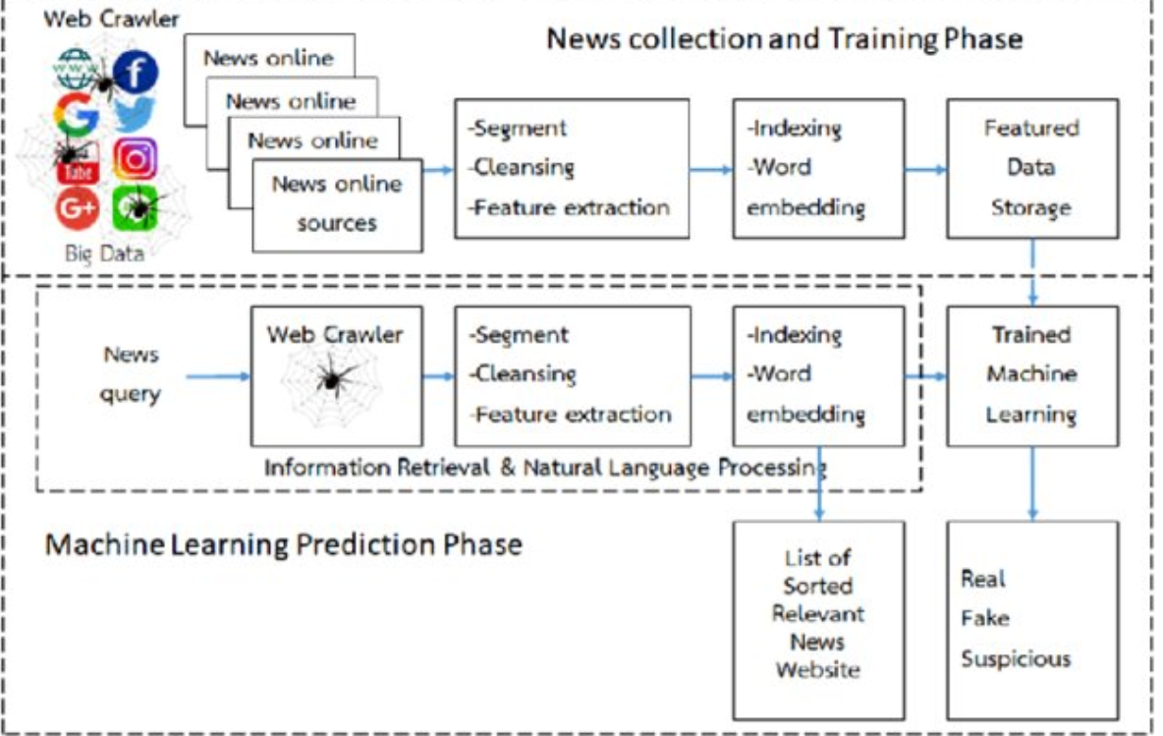
Design Selection:

Slide 17
Use of Modern tools in design and analysis
1. Natural Language Processing (NLP): NLP techniques are used to process and analyze text data from social media posts. Tools like NLTK (Natural Language Toolkit), SpaCy, and BERT (Bidirectional Encoder Representations from Transformers) are employed for tasks such as text classification, sentiment analysis, and entity recognition.
2. Machine Learning Algorithms: Supervised and unsupervised machine learning algorithms are applied to detect patterns in fake news content. Tools such as scikit-learn, TensorFlow, and PyTorch are used for building and training machine learning models for classification tasks.
3. Data Visualization: Tools like Matplotlib, Seaborn, and Tableau are used to visualize patterns and insights extracted from social media data. Visualization aids in understanding the spread and impact of fake news across different platforms and demographics.
4. Network Analysis: Social media platforms can be represented as networks, where users and their interactions form nodes and edges. Tools like NetworkX and Gephi are used to analyze the network structure and identify key influencers or communities spreading fake news.
5. Sentiment Analysis: Sentiment analysis tools such as VADER (Valence Aware Dictionary and sEntiment Reasoner) and TextBlob are employed to gauge the emotional tone of social media posts. Detecting sentiment helps in understanding the context and credibility of the information being shared.

Slide 18
Discussion and result analysis
Discussion Analysis:
1. Integration of Multiple Techniques: Combating fake news requires a multifaceted approach. By integrating various modern tools such as NLP, machine learning, sentiment analysis, and network analysis, researchers and practitioners can gain a comprehensive understanding of the fake news landscape on social media platforms.
2. Real-time Monitoring and Detection: The use of big data technologies and web scraping tools enables real-time monitoring and detection of fake news. This proactive approach allows for timely intervention to mitigate the spread of misinformation before it reaches a wider audience.
3. Adaptability to Evolving Tactics: Fake news perpetrators continually adapt their tactics to evade detection. Modern tools, particularly deep learning algorithms, offer the flexibility to evolve alongside these tactics. By continuously training models on new data, the effectiveness of fake news detection systems can be maintained.
4. Interdisciplinary Collaboration: Addressing the complex phenomenon of fake news necessitates collaboration across disciplines such as computer science, sociology, psychology, and communication studies. Modern tools provide a common framework for researchers from diverse backgrounds to collaborate and share insights.
5. Ethical Considerations: While modern tools empower researchers to combat fake news, ethical considerations must be paramount. Privacy concerns, algorithmic biases, and unintended consequences of intervention strategies need to be carefully addressed to ensure responsible use of these tools.

Slide 19
Discussion and result analysis
Result Analysis:
1. Improved Accuracy: The integration of advanced techniques such as deep learning has led to significant improvements in the accuracy of fake news detection systems. These systems can now distinguish between genuine and fake news with higher precision, reducing false positives and negatives.
2. Enhanced Scalability: Big data technologies enable the analysis of vast amounts of social media data, allowing researchers to scale their analyses to encompass larger populations and longer timeframes. This scalability is essential for capturing the dynamics of fake news propagation over time.
3. Identifying Key Patterns and Trends: By leveraging modern tools for data visualization and network analysis, researchers can identify key patterns and trends in fake news dissemination. Insights gleaned from these analyses can inform targeted interventions to disrupt the spread of misinformation.
4. User-Centric Approaches: Tools for user behavior analysis provide valuable insights into how individuals interact with fake news content. Understanding user behavior allows for the design of interventions that are tailored to the preferences and susceptibilities of different user segments.
5. Challenges and Limitations: Despite the advancements facilitated by modern tools, challenges remain in effectively combating fake news on social media. Adversarial attacks, where malicious actors deliberately manipulate content to evade detection, pose a significant challenge. Moreover, the dynamic nature of social media platforms requires continuous adaptation of detection algorithms to new trends and tactics.

Slide 20
Attainment of stated outcomes
1. Accuracy Improvement: Measure the increase in the accuracy of fake news detection systems compared to baseline approaches. This can be quantified through metrics such as precision, recall, and F1 score, indicating the system's ability to correctly identify fake news while minimizing false positives and false negatives.
2. Reduction in Dissemination: Analyze the impact of detection and intervention strategies on the dissemination of fake news. This could involve tracking the virality and reach of identified fake news posts before and after implementing mitigation measures.
3. Timeliness of Detection: Assess the timeliness of fake news detection by monitoring the duration between the posting of fake news content and its detection. Shorter detection times indicate a more effective response to emerging misinformation.
4. User Engagement with Fake News: Evaluate changes in user behavior, such as engagement rates (likes, shares, comments) with fake news content over time. A decrease in user engagement following the implementation of detection and intervention measures suggests a reduction in the influence of fake news.
5. Network Disruption: Measure the disruption of fake news dissemination networks by analyzing changes in network structure and connectivity over time. Identification and targeting of key nodes (users or accounts) involved in spreading fake news can help assess the effectiveness of intervention strategies.
6. Ethical Compliance: Ensure that the use of modern tools for fake news detection aligns with ethical principles and guidelines. Monitor compliance with privacy regulations, fairness considerations, and transparency in algorithmic decision-making to mitigate potential ethical risks.
7. Feedback and Adaptation: Solicit feedback from stakeholders, including researchers, social media platforms, and users, to continuously refine and improve detection algorithms and intervention strategies. Adaptation to emerging tactics and trends in fake news dissemination is essential for maintaining effectiveness over time.

Slide 21
Conclusion
The optimal solution for detecting social media fake news is a versatile and dynamic system that integrates cutting-edge technologies and methodologies to combat the spread of misinformation effectively.
This solution utilizes a blend of sophisticated machine learning algorithms, deep learning models, and multimodal analysis techniques to precisely detect fake news articles across diverse media formats and social media platforms.
Overall, the best social media fake news detection solution embodies accuracy, scalability, transparency, and adaptability, empowering users and platforms alike to combat the spread of misinformation and preserve the integrity of online information ecosystems.

Slide 22
Future Scope
Multimodal Analysis Expansion: Extend the project's capabilities to include the analysis of not only text but also images and videos on social media for more comprehensive fake news detection.
Cross-Platform Integration: Explore opportunities to expand the fake news detection system to cover a wider array of social media platforms.
User Feedback Mechanism: Implement a feedback loop that allows users to report potentially false information.
Integration with Educational Institutions: Collaborate with educational institutions to incorporate fake news detection and media literacy training into curricula, empowering students with critical thinking skills.

Slide 23
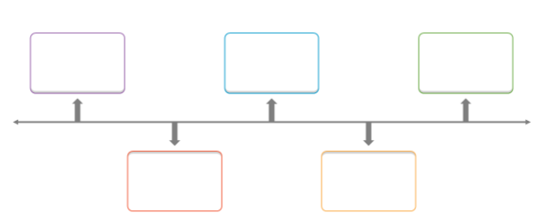
Timeline
Collection of information, Forming Problem and analyzing the objectives
Analyzing features and constraint
15/2/2024
20/4/2024
3/2/2024
1/3/2024
Methodology and implementation of coding part
Analyzing modern tools, result and attainment of stated outcomes & Implementation

Slide 24
References
[1] S. Busari, "How fake news does real harm," 24 April 2017. [Online]. Available: https://ted.com/talks/stephanie_busari_how_fak e_news_does_real_harm/., 2017
[2] M. Anderson, "Social media causes some users to rethink their views on an issue," 7 November 2016. [Online]. Available: http://www.pewresearch.org/facttank/2016/11/07/social-media-causes-someusers-torethink-their-views-on-an-issue/2016 .
[3] O. J. Nwachukwu, "Ex-British lawmaker,Eric Stuart pronounces President Buhari dead," 22 May 2017. [Online]. Available: http://dailypost.ng/2017/05/22/ex British_lawmaker_eric_stuart_pronounces_preside nt_buhari_dead.
[4] M. Gabielkov, A. Ramachandran, A. Chaintreau and A. Legout, "Social Clicks: What and Who Gets Read on Twitter?," Proceedings of the 2016 ACM SIGMETRICS International Conference on Measurement and Modeling of Computer Science, pp. 179- 192 , 2016.
[5] Jan Svoboda, Jonathan Masci, Federico Monti, Michael M Bronstein, and Leonidas Guibas. Peernets: Exploiting peer wisdom against adversarial attacks. In Proc. ICLR, 2019.
[6] Eugenio Tacchini, Gabriele Ballarin, Marco L Della Vedova, Stefano Moret, and Luca de Alfaro. Some like it hoax: Automated fake news detection in social networks. arXiv:1704.07506, 2017. [7] Petar Velickovic, Guillem Cucurull, Arantxa Casanova, Adriana Romero, Pietro Lio, and Yoshua Bengio. Graph attention networks. In Proc. ICLR, 2018.
[7] Petar Velickovic, Guillem Cucurull, Arantxa Casanova, Adriana Romero, Pietro Lio, and Yoshua Bengio. Graph attention networks. In Proc. ICLR, 2018.
[8] Soroush Vosoughi, Deb Roy, and Sinan Aral. The spread of true and false news online. Science, 359(6380):1146–1151, 2018.

